Slide 1
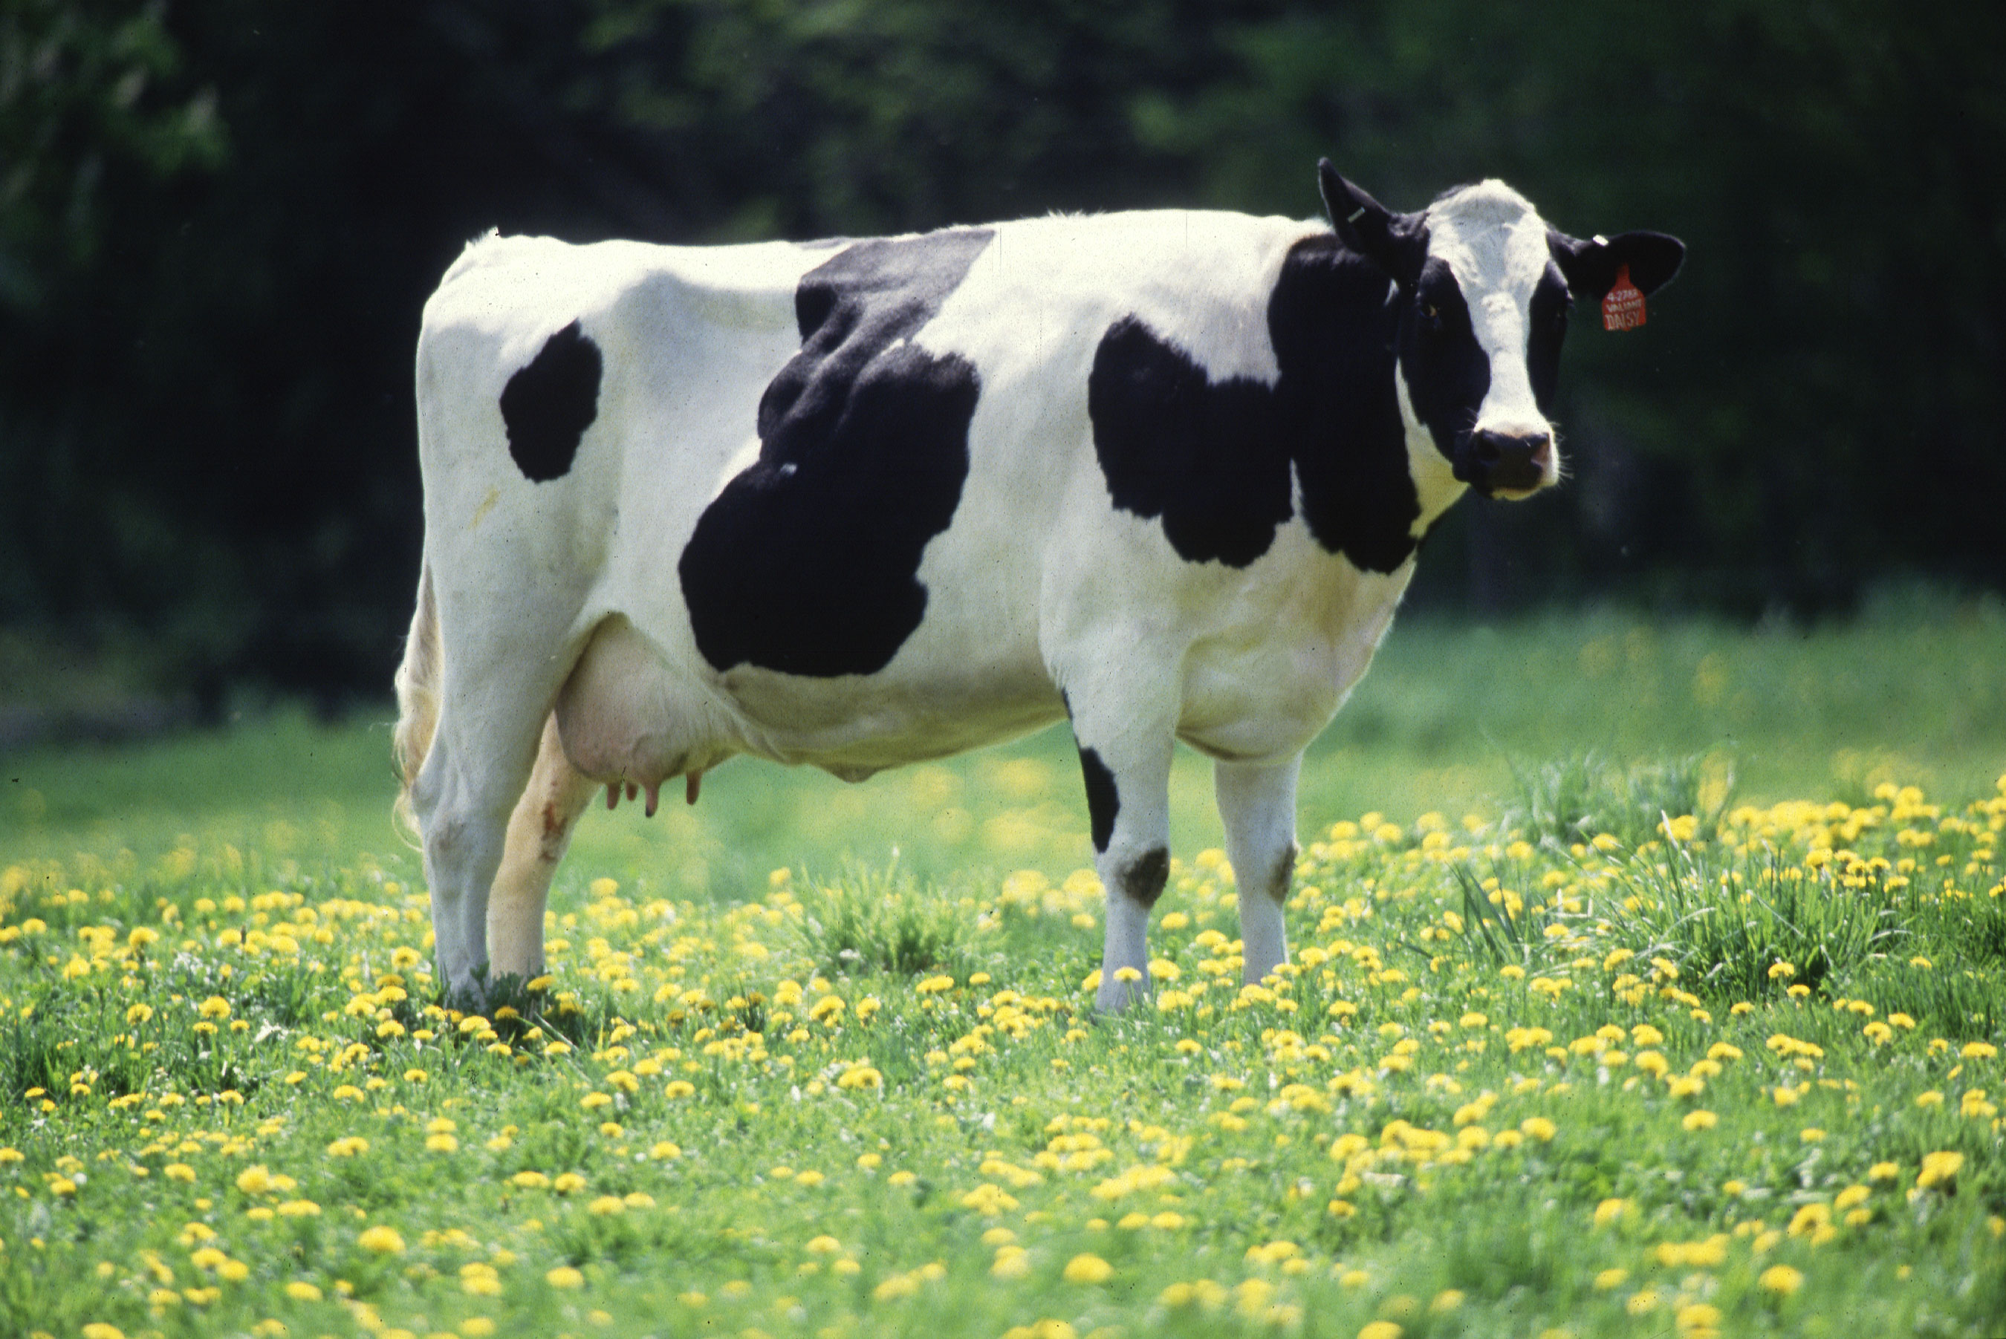
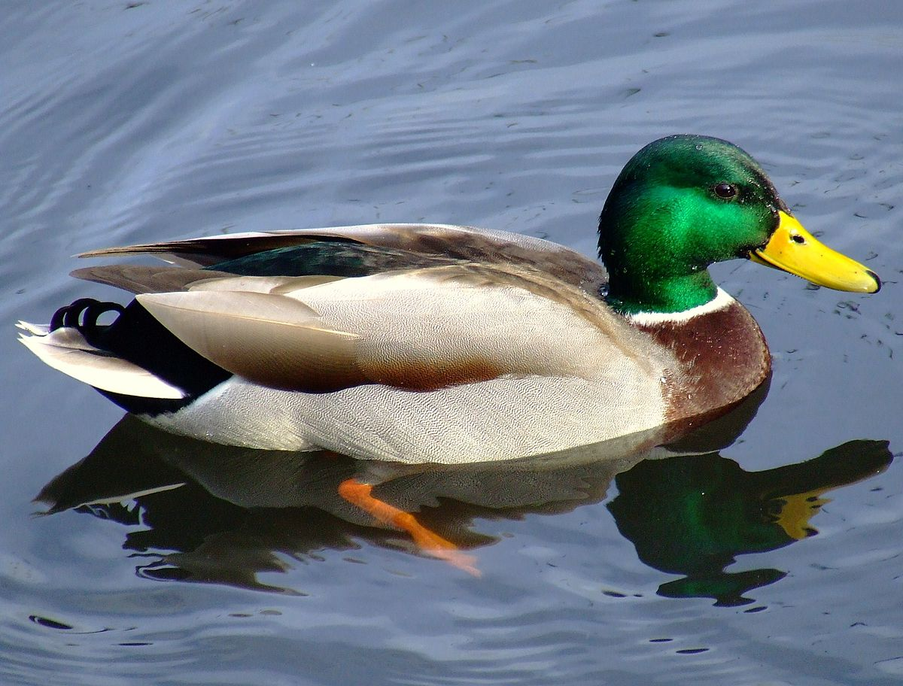
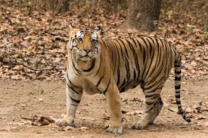
Daily Review
A characteristic is a feature of an object.
On your whiteboard, list 3 characteristics these animals have in common.
On your whiteboard, list 2 characteristics that are different between the animals.

Slide 2
Characteristics of Living Things

Slide 3
Learning Objective
CFU
What are we going to learn?
Identify the 7 characteristics of living things
Identify things as living, non-living or dead
Activate Prior Knowledge
Think, Pair, Share: Name three living things. What makes them living?

Slide 4
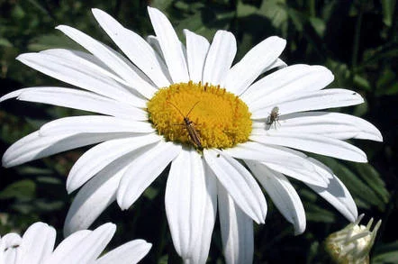
Concept Development
CFU 1
How many characteristics do living things have in common?
Living Things
All living things have 7 characteristics in common.
They can be remembered by using the acronym MR GREEN
CFU 2
What is the acronym that we use to remember the characteristics?
Vocabulary
Characteristic: feature or quality

Slide 5
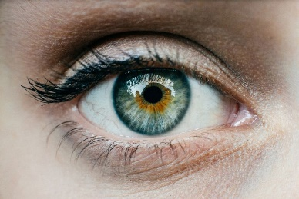
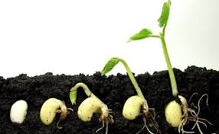
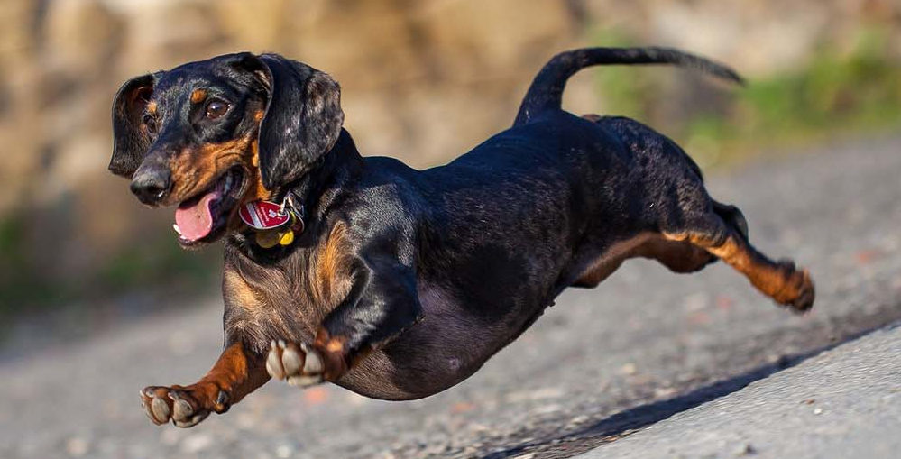
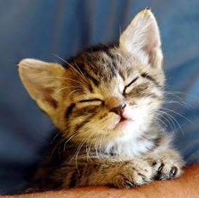
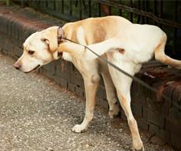

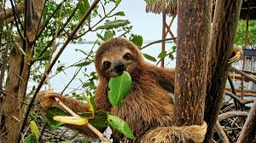
Concept Development
CFU 1
How do humans exchange gases with the environment?
MR GREEN
Move to find the resources they need
Respond to changes in their environment
Grow as they get older
Reproduce to make new individuals
Excrete waste products from their bodies
Exchange gases with their environment
Nutrition from food and water
CFU 2
A plant closes its flowers at night. Which characteristic/s does this demonstrate? Explain your choice.
CFU 3
Think, pair, share: How do plants get their food?
Vocabulary
Characteristic: feature or quality

Slide 6
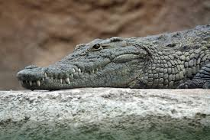
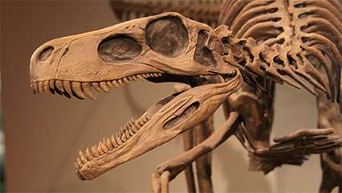
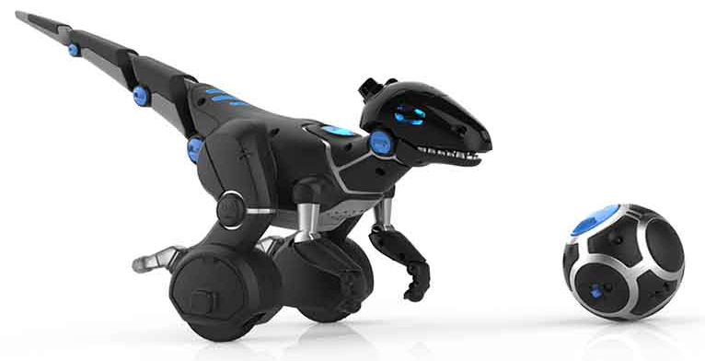
Concept Development
CFU 1
Which characteristics does the crocodile show? Is it living, non-living or dead?
Living, Non-living or Dead
Living things have all 7 characteristics
Non-living things may have some, but not all, 7 characteristics
Dead things once had all 7 characteristics but now have none
CFU 2
Which characteristics does the dinosaur fossil show? Is it living, non-living or dead?
CFU 3
Which characteristics does the robotic dinosaur show? Is it living, non-living or dead?
Reminder
Move to find the resources they need Respond to changes in their environment Grow as they get older Reproduce to make new individuals Excrete waste products from their bodies Exchange gases with their environment Nutrition from food and water
Vocabulary
Characteristic: feature or quality

Slide 7
Skill Development/Guided Practice
CFU 1
What characteristics does it have?
Identifying living, non-living and dead
Identify which characteristics the object has. Does it have all 7 characteristics? = living Does it have none, but once had all 7 characteristics = dead Does it have some or none, but never had all 7 = non-living
Is a cow living, non-living or dead?
CFU 2
Does it have all the characteristics?
CFU 3
Does it have none or some of the characteristics?
A cow is living because it has all 7 characteristics
Reminder
Move to find the resources they need Respond to changes in their environment Grow as they get older Reproduce to make new individuals Excrete waste products from their bodies Exchange gases with their environment Nutrition from food and water

Slide 8
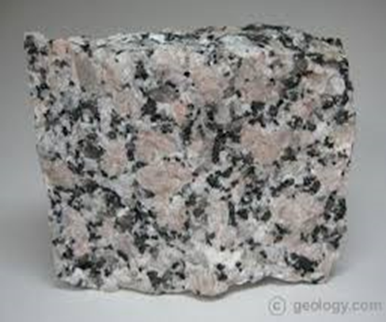
Skill Development/Guided Practice
CFU 1
What characteristics does it have?
Identifying living, non-living and dead
Identify which characteristics the object has. Does it have all 7 characteristics? = living Does it have none, but once had all 7 characteristics = dead Does it have some or none, but never had all 7 = non-living
Is a rock living, non-living or dead?
CFU 2
Does it have all the characteristics?
CFU 3
Does it have none or some of the characteristics?
A rock is non-living because it has none of the 7 characteristics and never did.
Reminder
Move to find the resources they need Respond to changes in their environment Grow as they get older Reproduce to make new individuals Excrete waste products from their bodies Exchange gases with their environment Nutrition from food and water

Slide 9
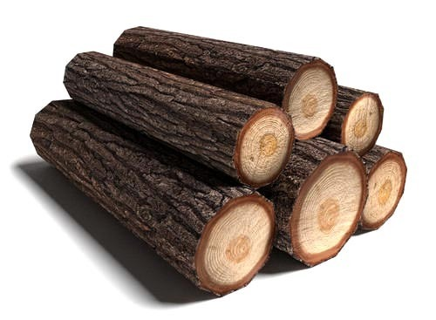
Skill Development/Guided Practice
CFU 1
What characteristics does it have?
Identifying living, non-living and dead
Identify which characteristics the object has. Does it have all 7 characteristics? = living Does it have none, but once had all 7 characteristics = dead Does it have some or none, but never had all 7 = non-living
Is a log living, non-living or dead?
CFU 2
Does it have all the characteristics?
CFU 3
Does it have none or some of the characteristics?
A log is dead because it has none of the 7 characteristics, but once did.
Reminder
Move to find the resources they need Respond to changes in their environment Grow as they get older Reproduce to make new individuals Excrete waste products from their bodies Exchange gases with their environment Nutrition from food and water

Slide 10

Skill Development/Guided Practice
CFU 1
What characteristics does it have?
Identifying living, non-living and dead
Identify which characteristics the object has. Does it have all 7 characteristics? = living Does it have none, but once had all 7 characteristics = dead Does it have some or none, but never had all 7 = non-living
Is a paper clip living, non-living or dead?
CFU 2
Does it have all the characteristics?
CFU 3
Does it have none or some of the characteristics?
A paper clip is ______ because it has _____ of the 7 characteristics, and _________.
Reminder
Move to find the resources they need Respond to changes in their environment Grow as they get older Reproduce to make new individuals Excrete waste products from their bodies Exchange gases with their environment Nutrition from food and water

Slide 11
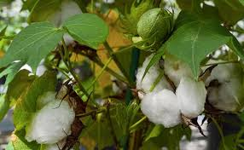
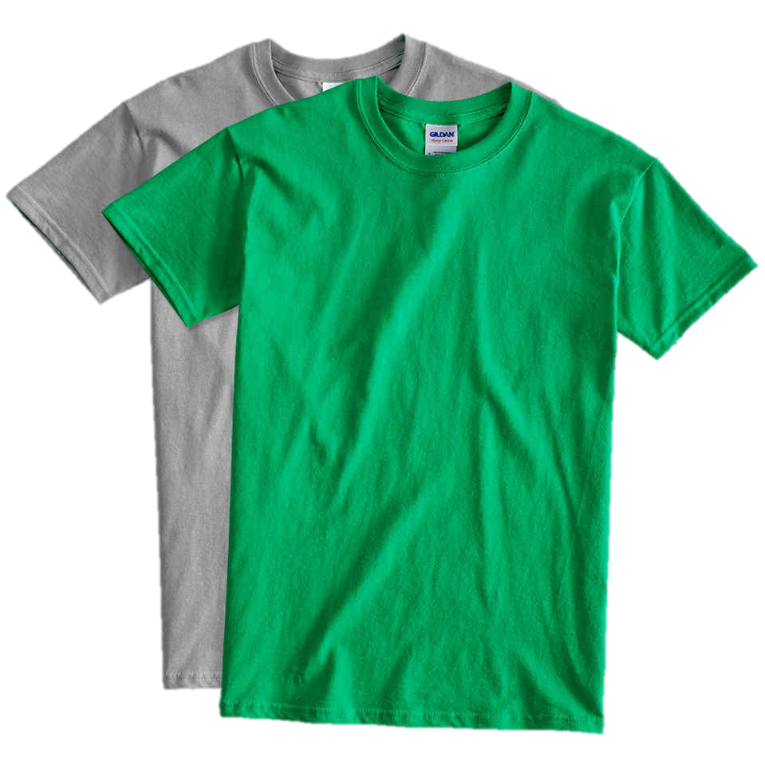
Skill Development/Guided Practice
CFU 1
What characteristics does it have?
Identifying living, non-living and dead
Identify which characteristics the object has. Does it have all 7 characteristics? = living Does it have none, but once had all 7 characteristics = dead Does it have some or none, but never had all 7 = non-living
Is a cotton t-shirt living, non-living or dead?
CFU 2
Does it have all the characteristics?
CFU 3
Does it have none or some of the characteristics?
Reminder
Move to find the resources they need Respond to changes in their environment Grow as they get older Reproduce to make new individuals Excrete waste products from their bodies Exchange gases with their environment Nutrition from food and water
A cotton t-shirt is ______ because it has _____ of the 7 characteristics, and _________.

Slide 12
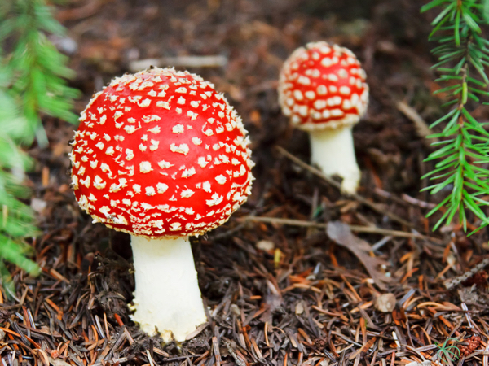
Skill Development/Guided Practice
CFU 1
What characteristics does it have?
Identifying living, non-living and dead
Identify which characteristics the object has. Does it have all 7 characteristics? = living Does it have none, but once had all 7 characteristics = dead Does it have some or none, but never had all 7 = non-living
Is a fungus living, non-living or dead?
CFU 2
Does it have all the characteristics?
CFU 3
Does it have none or some of the characteristics?
Reminder
Move to find the resources they need Respond to changes in their environment Grow as they get older Reproduce to make new individuals Excrete waste products from their bodies Exchange gases with their environment Nutrition from food and water

Slide 13
Relevance
Biology is the study of living things and what it means to be alive.
Knowing the characteristics of living things will help you understand the difference between living and non-living things.

Slide 14
Skill Closure
Reminder
Move to find the resources they need Respond to changes in their environment Grow as they get older Reproduce to make new individuals Excrete waste products from their bodies Exchange gases with their environment Nutrition from food and water
Name four of the 7 characteristics of living things.
Skill Closure
Is a log of wood non-living or dead? Explain your choice.
Skill Closure
Fred says a car is living because it moves, excretes waste and requires nutrition. Is he correct? Why or why not?

Slide 15
Independent Practice
Complete the worksheets on Characteristics of Living Things.

